Slide 2


the value of
Accurate Approximations
Ideal for use with reSolve Year 8 Circumference: Lesson 3

Slide 3
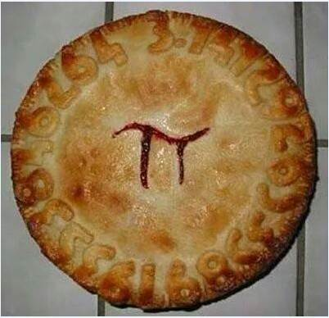
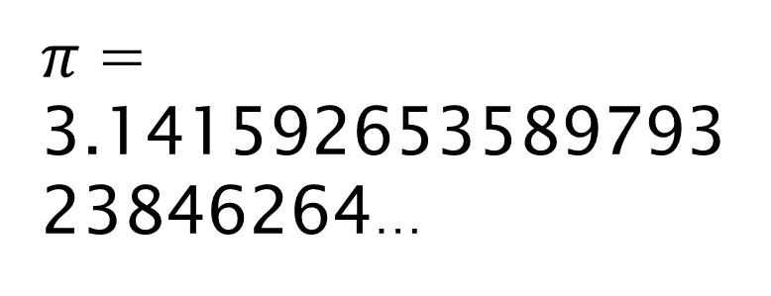
What is Wrong with this Pi?
$π$ = 3.14159265358979323846264…
(a 5 and a 2 are stuck on the pie backwards)

Slide 4
Estimating around circles

Slide 5
How this works…
Hold up your symbol showing > or < to show if the particular property – circumference, diameter or radius – is greater than or less than the stated value.
Don’t take too long making each decision; you are allowed to change your mind as you get more information with each slide!
Eventually you will be given a measurement and you will need to use the π button on your calculator to get the exact solution.
Think about:
What is a reasonable estimate?
When does having more information help?
How accurate can your answer reasonably be?

Slide 6
is one revolution OF…
the large wheel of a
penny-farthing bicycle
more than, or less than,
5 metres?

Slide 7
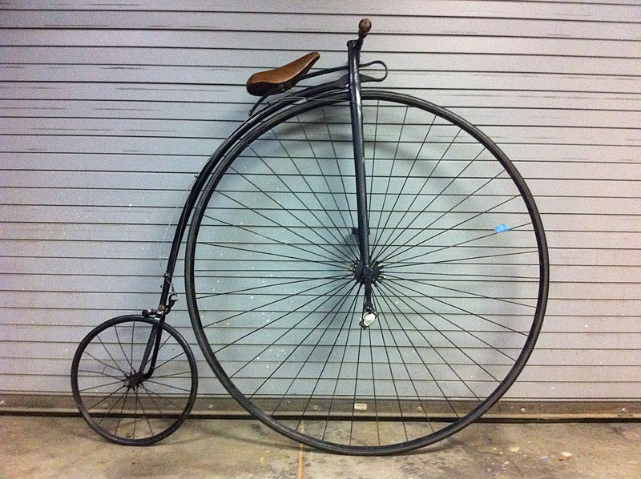
is one revolution OF…
the large wheel of a
penny-farthing bicycle
more than, or less than,
5 metres?
Image taken from https://commons.wikimedia.org/wiki/File:Ariel_50_inch_High_Wheel_Bike.jpg?uselang=en-gb

Slide 8
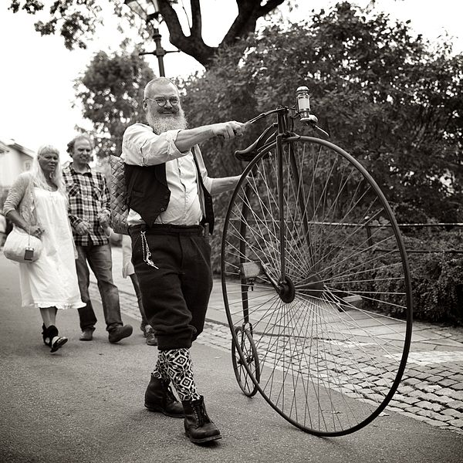
is one revolution OF…
the large wheel of a
penny-farthing bicycle
more than, or less than,
5 metres?
Image taken from https://commons.wikimedia.org/wiki/File:High_wheeler.jpg?uselang=en-gb

Slide 9
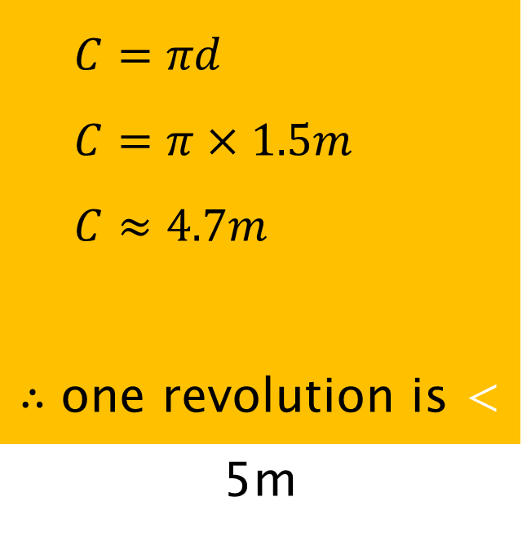
is one revolution OF…
the large wheel of a
penny-farthing bicycle
more than, or less than,
5 metres . . .
when the large wheel
diameter is 1.5m ?
$$C=πd$$
$$C=π×1.5m$$
$$C≈4.7m$$
$∴$ one revolution is < 5m

Slide 10
is the diameter of…
the tyre from a
mining dump truck
more than, or less than,
2.5 metres?

Slide 11
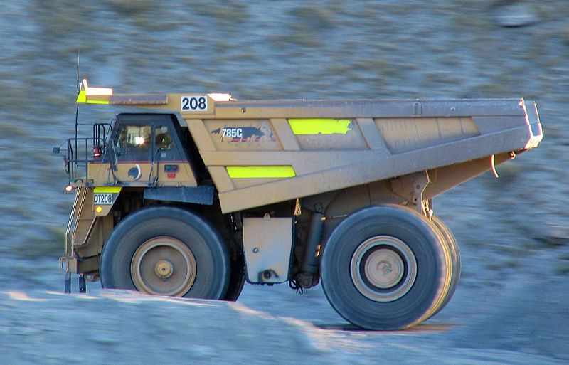
Is the diameter of…
the tyre from a
mining dump truck
more than, or less than,
2.5 metres?
Image taken from https://commons.wikimedia.org/wiki/File:OceanaGold_mining_truck_Macraes,_NZ.jpg?uselang=en-gb

Slide 12

Is the diameter of…
$C=πd$
$7.40=πd$
$\frac{7.40}{π}=d$
$2.36 \sim d$
$∴$ tyre diameter is < 2.5m
the tyre from a
mining dump truck
more than, or less than,
2.5 metres…
if one revolution of the
wheel is 7.40 m?

Slide 13
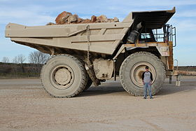
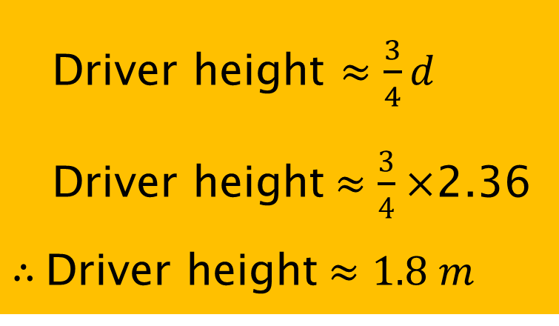
So how tall is the driver if…
the tyre diameter is 2.36m ?
Image taken from https://en.wikipedia.org/wiki/Dump_truck#Off-highway_dump_trucks
Driver height $≈\frac{3}{4}d$
Driver height$≈\frac{3}{4}×$2.36
$∴$Driver height$≈1.8 m$

Slide 14
Is the armspan of…
2016 Australian
Stone Lifting record holder
Jordan “Biggie” Steffens
more than, or less than
185 cm?

Slide 15
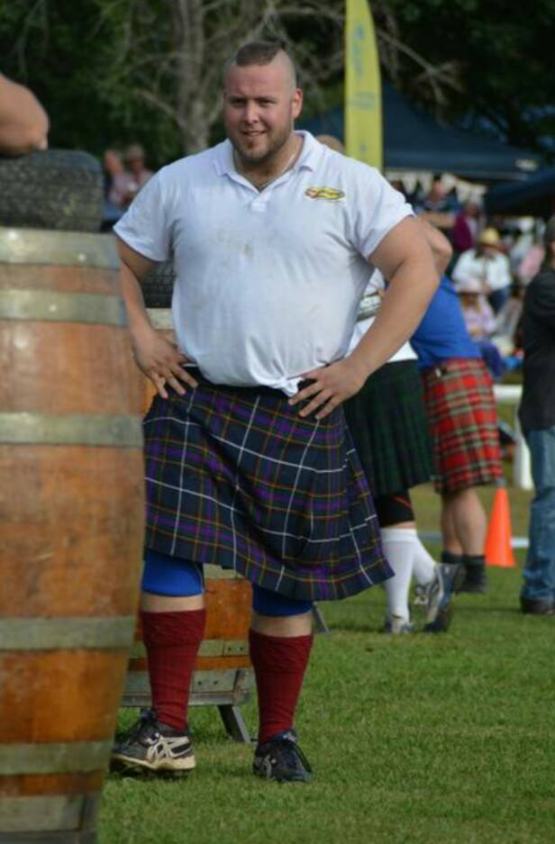
Is the armspan of…
2016 Australian
Stone Lifting record holder
Jordan “Biggie” Steffens
more than, or less than
185 cm?
https://www.facebook.com/JordanBiggieSteffens/photos/pb.1417549851795678.-2207520000.1462506331./1592170654333596/?type=3&theater

Slide 16
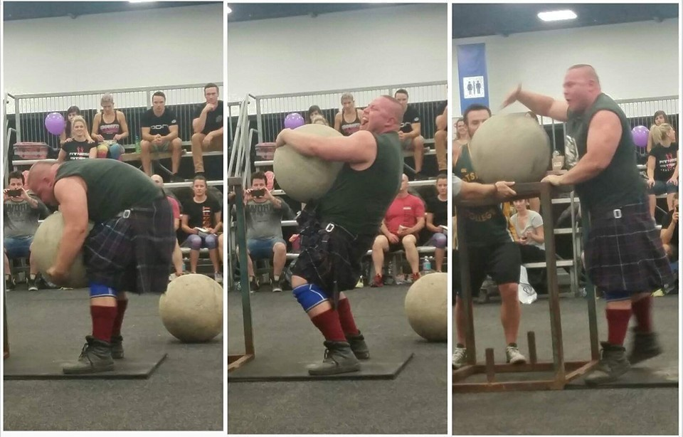
Is the armspan of…
2016 Australian
Stone Lifting record holder
Jordan “Biggie” Steffens
more than, or less than
185 cm?

Slide 17
Is the armspan of…
2016 Australian
Stone Lifting record holder
Jordan “Biggie” Steffens
more than, or less than
185cm . . .
given the 165kg stone* he is lifting has a diameter of 50cm ?
*His 2016 Australian Record lift was a 213.0kg stone

Slide 18


Is the armspan of…
$$\text{stone} \text{circumference}= π d$$
$≈π$× 50 $≈$ 157cm
2016 Australian
Stone Lifting record holder
Jordan “Biggie” Steffens
more than, or less than
185cm . . .
given the 165kg stone* he is lifting has a diameter of 50cm ?
$∴armspan≈$
160cm
*His 2016 Australian Record lift was a 213.0kg stone

Slide 19
Does the…
tip of the minute hand
of a “standard” wall clock
travel more than, or less than
1 metre in one revolution?

Slide 20
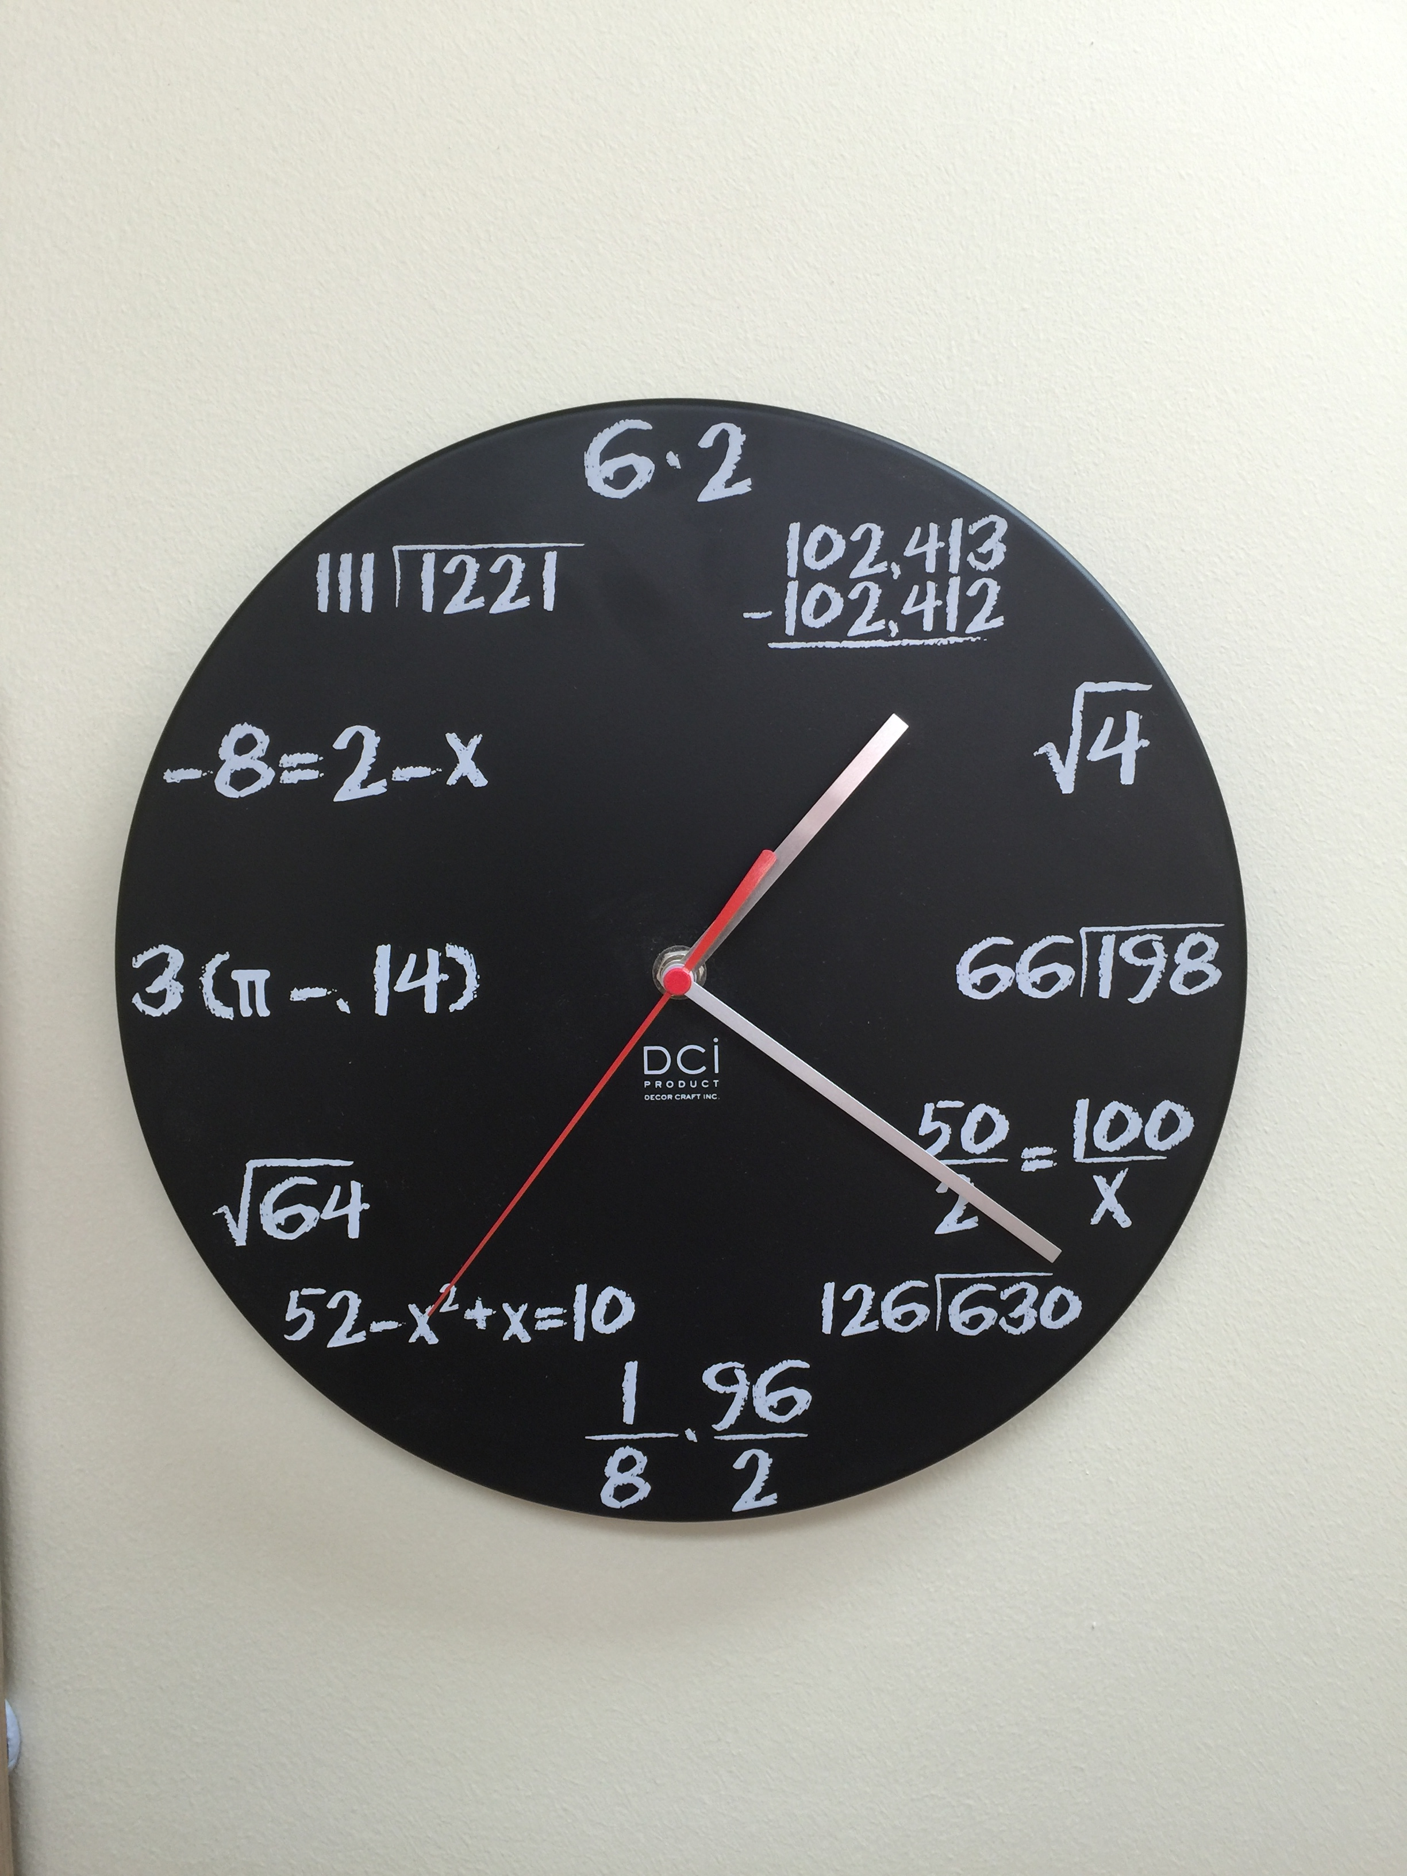
Does the…
tip of the minute hand
of a “standard” wall clock
travel more than, or less than
1 metre in one revolution?

Slide 21
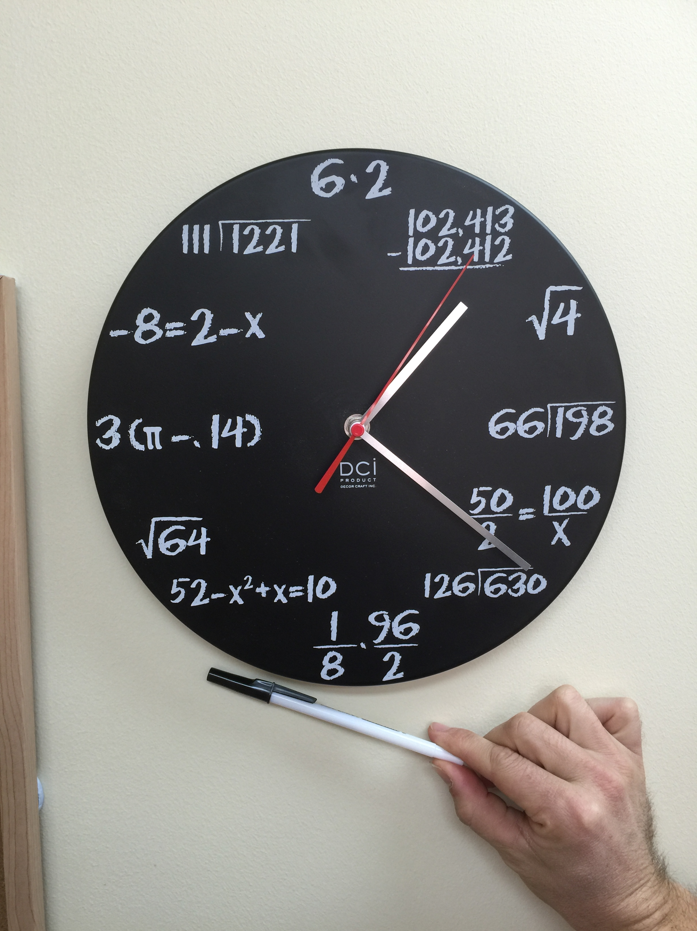
Does the…
tip of the minute hand
of a “standard” wall clock
travel more than, or less than
1 metre in one revolution?

Slide 22

Does the…
tip of the minute hand
of a “standard” wall clock
travel more than, or less than
1 metre in one revolution…
…if the minute hand is 12.5 cm long ?
$$C=2πr$$
$$C=2×π×12.5 cm$$
$$C ≈ 78.5 cm$$
$∴$ one revolution is < 1 m

Slide 23
So how fast is…
the tip of this minute hand going
if it is 12.5cm long?

Slide 24

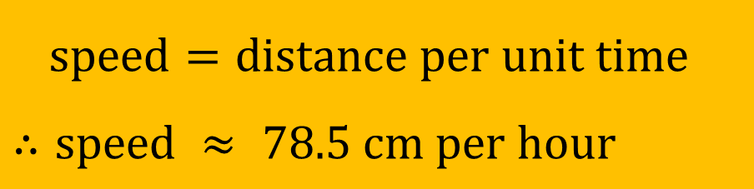
So how fast is…
The tip of this minute hand going
if it is 12.5cm long?
$$C=2πr$$
$$C=2×π×12.5cm$$
$$C ≈ 78.5cm$$
$speed=distance per unit time$
$∴$ $speed ≈ 78.5 cm per hour$

Slide 25
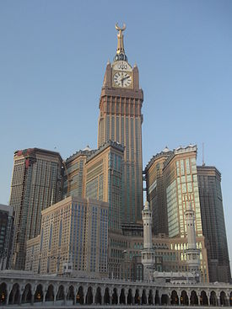
So how fast is…
the tip of the minute hand on
Abraj Al-Bait Tower in
Mecca, Saudi Arabia
(the world’s largest clock)?
Image taken from https://en.wikipedia.org/wiki/Abraj_Al_Bait

Slide 26



So how fast is…
$$\text{given} \text{that}\text{…}$$
$d=43m$
the tip of the minute hand on
Abraj Al-Bait Tower in
Mecca, Saudi Arabia
(the world’s largest clock)?
Image taken from https://en.wikipedia.org/wiki/Abraj_Al_Bait
$$C=πd$$
$$C=π×43m$$
$$C ≈135m$$
$\text{speed} ≈$
$$135 \text{m} \text{per} \text{hour}\text{ (}\text{or}\text{ 0.}\text{135}\text{km}\text{/}\text{h})$$

Slide 27
is the circumference of…
Venus, our nearest
planet, more than,
or less than,
40 000km ?

Slide 28
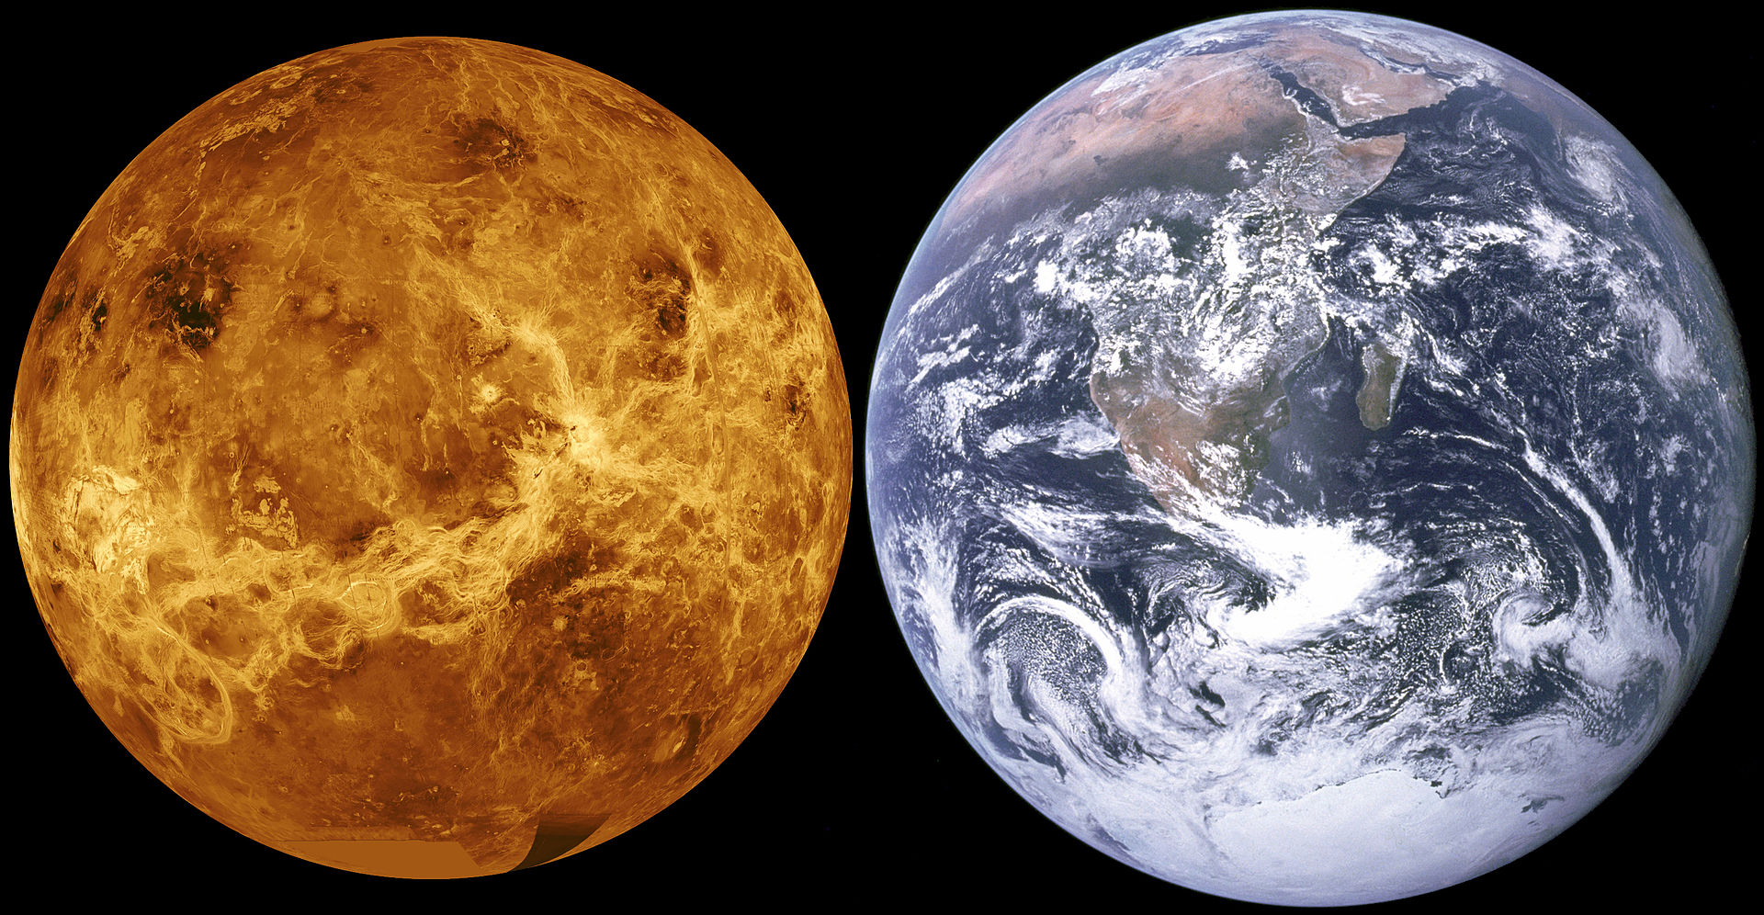
is the circumference of…
Venus, our nearest
planet, more than,
or less than,
40 000km?
https://en.wikipedia.org/wiki/Venus

Slide 29



is the circumference of…
$$38 025 \text{km}$$
$$\text{circumference} ≈$$
Venus, our nearest
planet, more than,
or less than,
40 000km…
https://en.wikipedia.org/wiki/Venus
$$\text{given} \text{that} r=6 051.8 \text{km}?$$

Slide 30
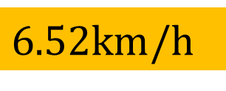


CHALLENGE: What is the rotationAL velocity of…
…the Earth rotates at 1 674 km/h!
Venus, our nearest
planet, if one ‘day’ of
its rotation lasts 243 Earth days?
https://en.wikipedia.org/wiki/Venus
$$\text{recall}\text{: }\text{circumference} ≈$$
$$38 025\text{km}$$
$$∴\text{velocity} ≈$$
$6.52\text{km}$/h
… the slowest planet rotation speed in our Solar System!
(this is how fast a point on the equator of Venus is moving due to its rotation)

Slide 31
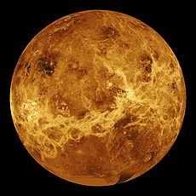
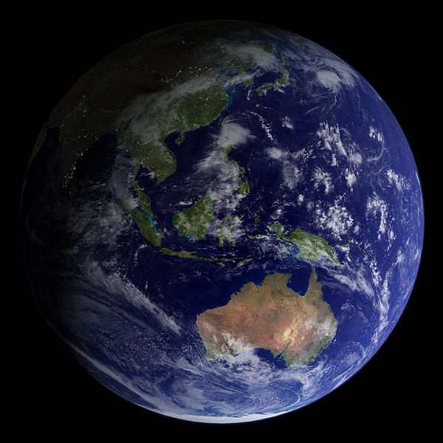
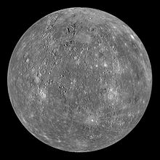

Does venus move…
Orbital path $≈$ $2×π×$108 000 000km
$≈$ 678 584 000 km
$≈$ 679 000 000 km
more than, or less than,
1 000 000 000 km during its
225 Earth day long orbit
around our sun?
https://en.wikipedia.org/wiki/Mercury_(planet)
https://en.wikipedia.org/wiki/Venus
https://commons.wikimedia.org/wiki/File:Sydney,_Australia_-_Flickr_-_NASA_Goddard_Photo_and_Video.jpg
Average distance from sun =108 000 000 km

Slide 32
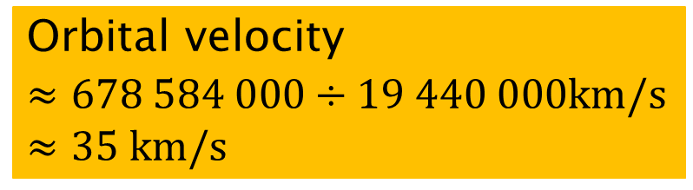


Does venus move…
Orbital velocity $≈678 584 000÷19 440 000$km/s
$$≈35 km/s$$
Faster than, or slower than,
40 km per second?
https://en.wikipedia.org/wiki/Mercury_(planet)
https://en.wikipedia.org/wiki/Venus
https://commons.wikimedia.org/wiki/File:Sydney,_Australia_-_Flickr_-_NASA_Goddard_Photo_and_Video.jpg
Average distance from sun =108 000 000 km
$recall:orbital path ≈$ $678 584 000 km$
$orbital period ≈225 days$
$$≈225×24×60×60 seconds$$
$$≈19 440 000 seconds$$

Slide 33
Is one revolution of…
a gondola on the London
Eye more than, or less
than 400m?

Slide 34
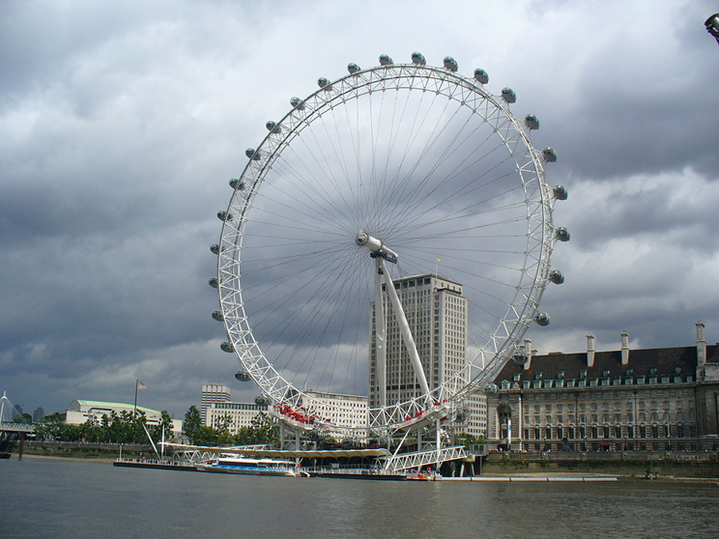
Is one revolution of…
a gondola on the London
Eye more than, or less
than 400m?
By hobbesnblue, CC BY-SA 3.0, https://commons.wikimedia.org/w/index.php?curid=47383540

Slide 35
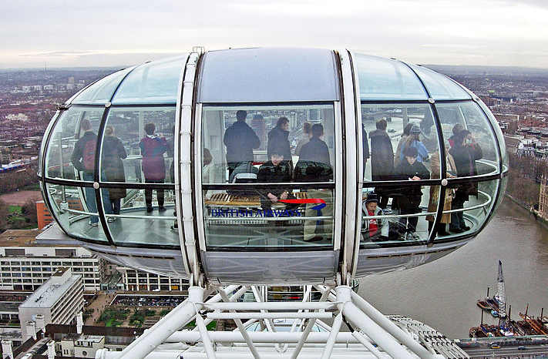
Is one revolution of…
a gondola on the London
Eye more than, or less
than 400m?
Image taken from https://commons.wikimedia.org/wiki/File:London_Eye_Pod.jpg?uselang=en-gb
By hobbesnblue, CC BY-SA 3.0, https://commons.wikimedia.org/w/index.php?curid=4738354

Slide 36



Is one revolution of…
$$\text{O}\text{ne} \text{revolution} ≈$$
$$377\text{m}$$
a gondola on the London
Eye more than, or less
than 400m?
Image taken from https://commons.wikimedia.org/wiki/File:London_Eye_Pod.jpg?uselang=en-gb
By hobbesnblue, CC BY-SA 3.0, https://commons.wikimedia.org/w/index.php?curid=4738354
$$d=120\text{m}$$

Slide 37
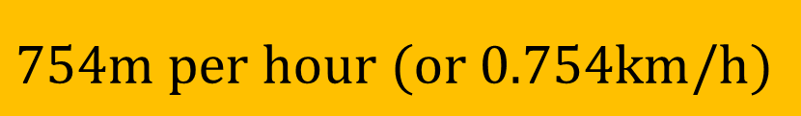

So how fast is…
$$\text{S}\text{peed} ≈$$
$$754m per hour (or 0.754km/h)$$
a gondola on the London
Eye if it takes 30 minutes
for one revolution?
Image taken from https://commons.wikimedia.org/wiki/File:London_Eye_Pod.jpg?uselang=en-gb
By hobbesnblue, CC BY-SA 3.0, https://commons.wikimedia.org/w/index.php?curid=4738354
$$d=120m$$

Slide 38
Is the…
diameter of a trundle
wheel more than,
or less than, 30 cm?

Slide 39
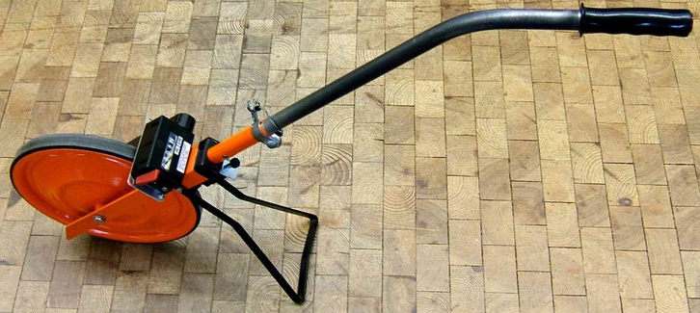
Is the…
diameter of a trundle
wheel more than,
or less than, 30 cm?
Image taken from https://commons.wikimedia.org/wiki/File:MessradSuricata.jpg

Slide 40
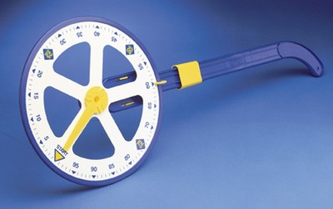
Is the…
diameter of a trundle
wheel more than,
or less than, 30 cm?
Image taken from http://www.chescientific.com/edu/product_228.aspx

Slide 41


Is the…
$$32 cm$$
$$\text{D}\text{iameter} ≈$$
diameter of a trundle
wheel more than,
or less than, 30 cm . . .
remembering that the
circumference is meant to be
exactly 1 m? Image taken from http://www.chescientific.com/edu/product_228.aspx

